Slide 1

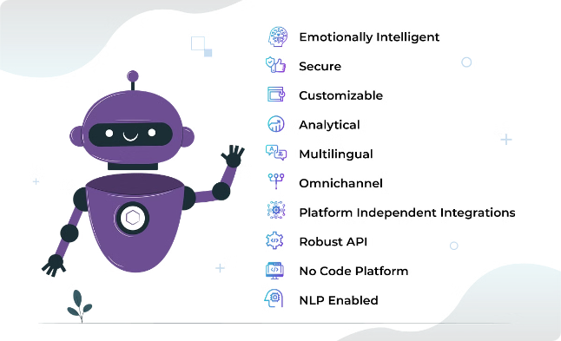

The Conversational Image Recognition Chatbot
Revolutionizing how users interact with images.

Slide 2

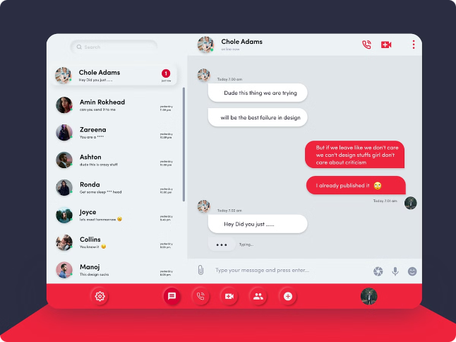




Seamless Interaction Experience
Natural Language
Multiple Platforms
Users interact with the chatbot using everyday language.
Accessible through web, mobile, and other devices.
Real-time Responses
Intuitive Interface
Prompt and efficient communication with users.
Easy to navigate and understand for everyone.

Slide 3


Querying and Obtaining Information
Image Analysis
User Queries
Relevant Information
The chatbot analyzes the image to extract key features.
Users ask questions about the image using natural language.
The chatbot provides answers, descriptions, or relevant data based on the image and user query.

Slide 4

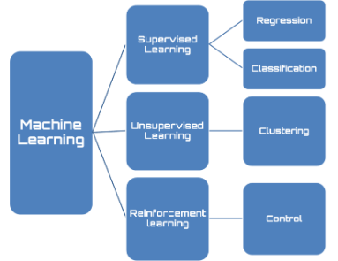



Leveraging Artificial Intelligence
1
Image Recognition
2
Natural Language Processing
AIML algorithms identify objects, scenes, and other elements in the image.
The chatbot understands user queries and generates human-like responses.
3
Data Analysis
4
Continuous Learning
Extracts valuable insights from images and user interactions.
The chatbot adapts and improves its responses over time.

Slide 5

Interpreting Queries and Analyzing Images
Image Upload
1
The user uploads an image to the chatbot.
2
Query Interpretation
The chatbot processes the user's question.
Image Analysis
3
The chatbot identifies relevant features in the image.
4
Response Generation
The chatbot generates a relevant and informative response.
Delivery
5
The chatbot presents the response to the user.

Slide 6

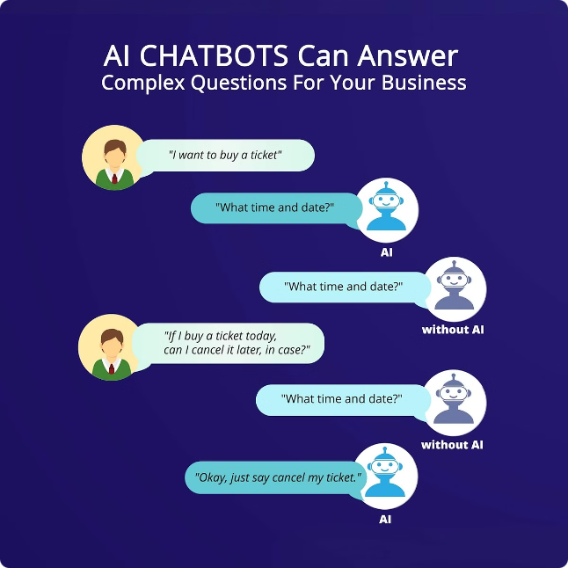
Delivering Relevant Responses in Real-time
Image Analysis
Text Description
Object Recognition
User Query
Related Information
Data Extraction
Response Generation
Contextual Answers
Personalized Recommendations

Slide 7


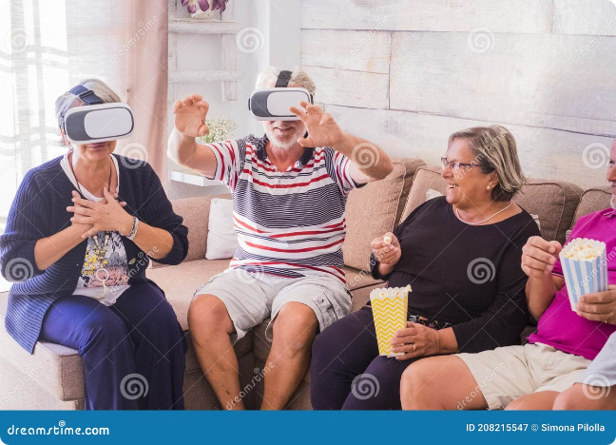


Enhancing User Engagement
Personalized Experiences
Tailored responses based on user preferences and past interactions.
Interactive Learning
Users can explore images and learn new things through engaging conversations.
Increased Accessibility
Provides information in a more accessible and user-friendly way.

Slide 8

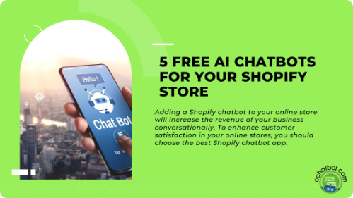




Applications in Diverse Domains
E-Commerce
Education
Product recommendations, visual search, and customer support.
Interactive learning, image recognition tasks, and visual explanations.
Healthcare
Travel
Medical image analysis, diagnosis support, and patient education.
Finding locations, identifying landmarks, and planning trips.

Slide 9

TEAM MEMBERS:
M.ROHITH
K.BHARGAV
K.MOKSHAGNA

